Slide 1
Virtual Motion Planning for Heavy Mobile Crane Lift Operations
M. Noghabaee, Navid Kayhani
Under Supervision of
H. Taghaddos (Ph.D.)

Slide 2
Main Idea
Experiment all of challenges in a lift in virtual environment
Without real hazards
Without an expense in compare to real-world trial
Have operator view(Crane Cabin) as well as plan view and a bird one!
Which object would be tricky in the lift
Examine the path which suggested by an application
…

Slide 3
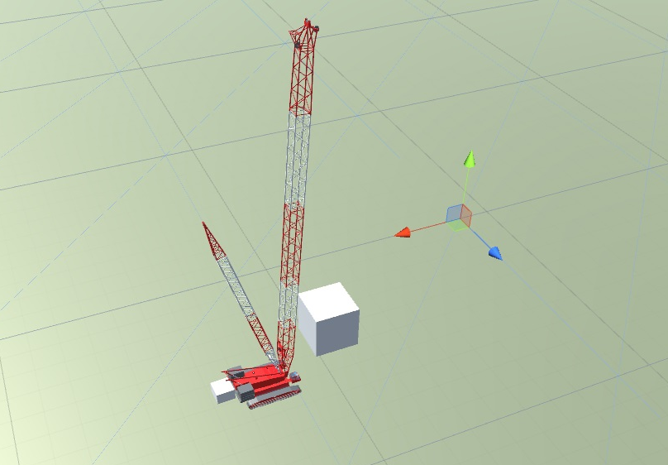
VR model first edition
Crane and all objects modeled in Uinty3D
Database includes
Sites conditions and items, Object dimensions and locations and also crane location
User could ride and control all degree of freedom of a real crane

Slide 4
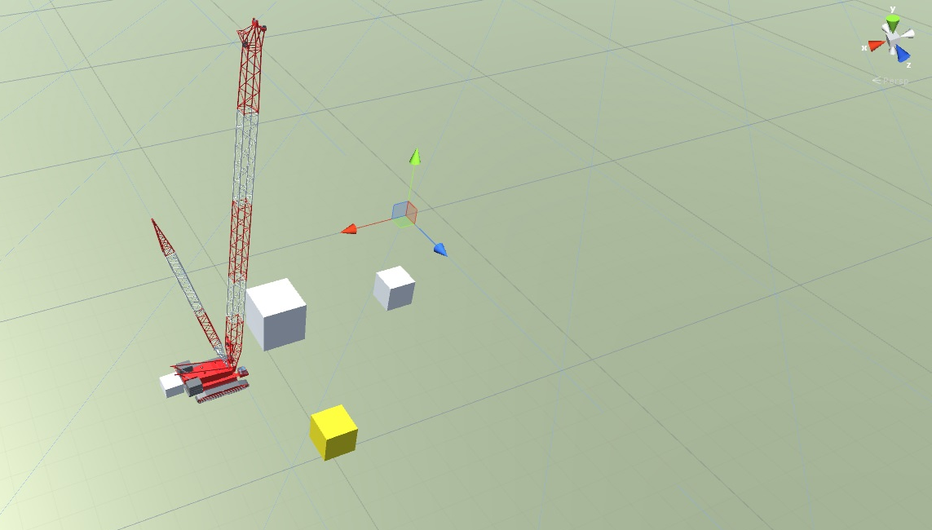
VR model first edition
Obstacles created form data was stored in database .
Distance between Obstacles and crane and its lifted object calculate each moment.
Yellow Obstacle is near than white one

Slide 5
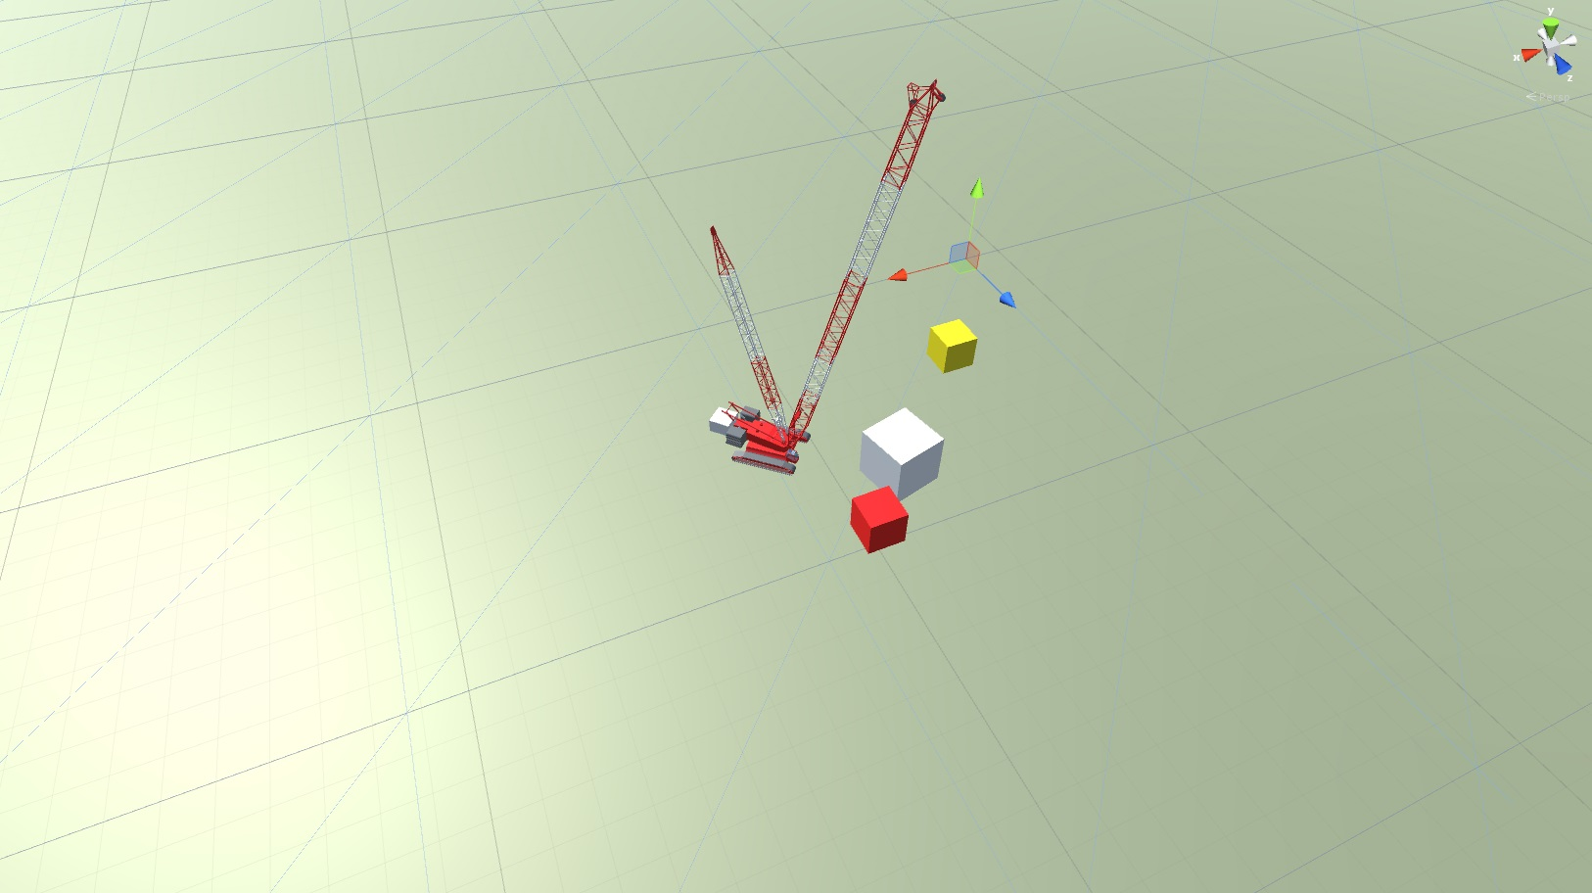
VR model first edition
More graphics and Crane Creation in Second edition
If the distance becomes less than the clearance the obstruction’s color will be changed to red

Slide 6
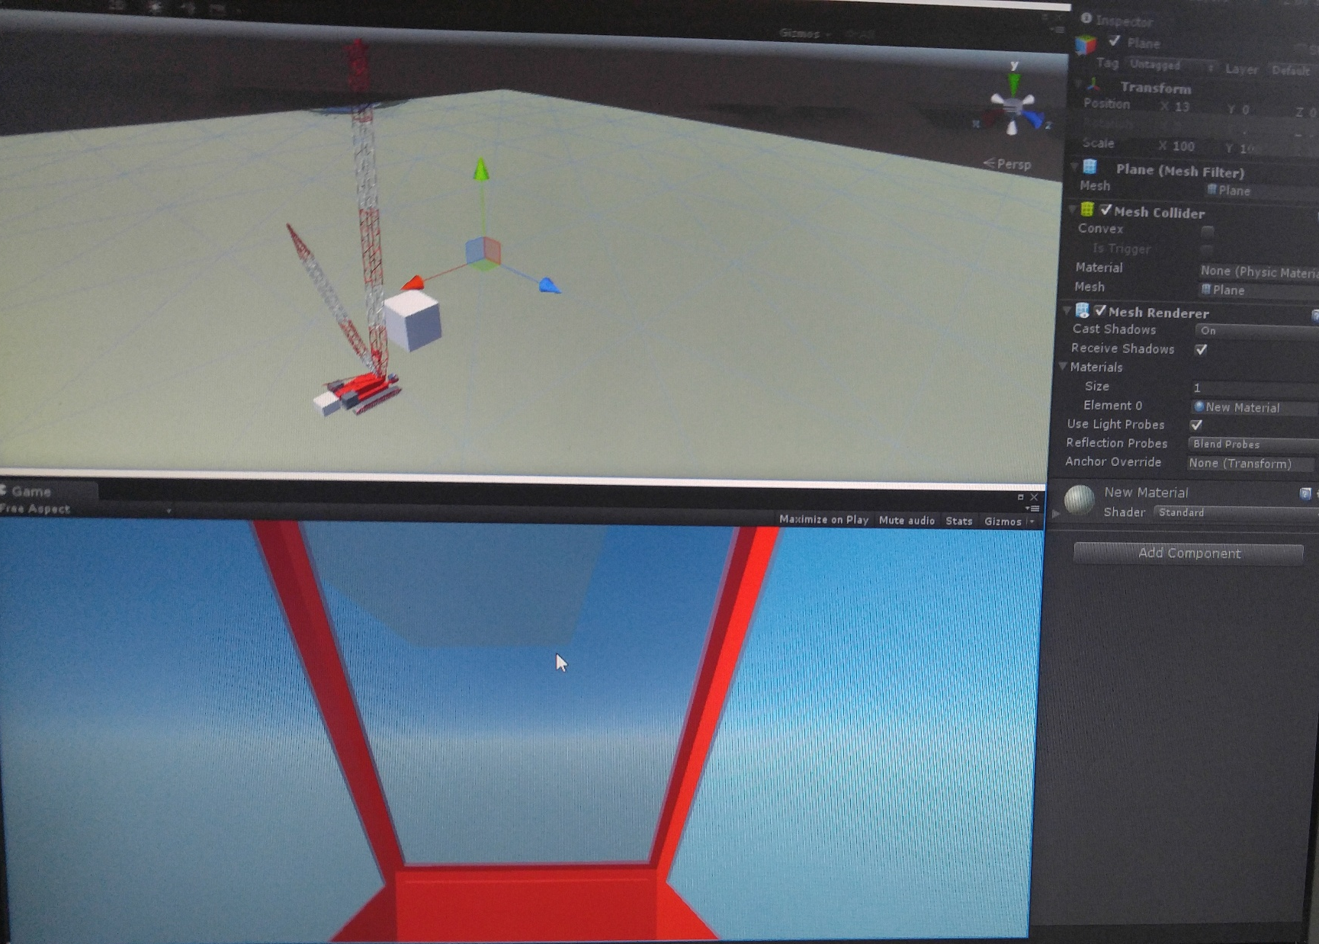
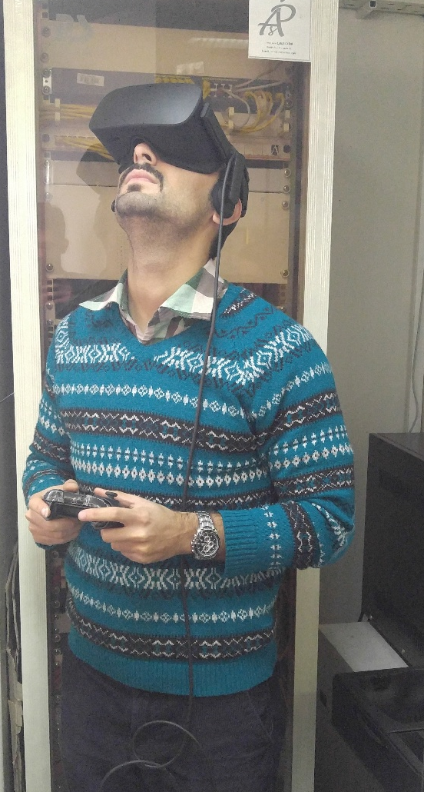
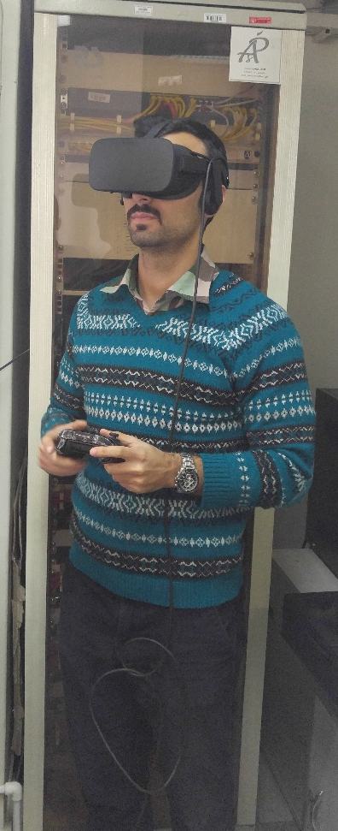
A user tries to ride a crane!!
Cabin view

Slide 7
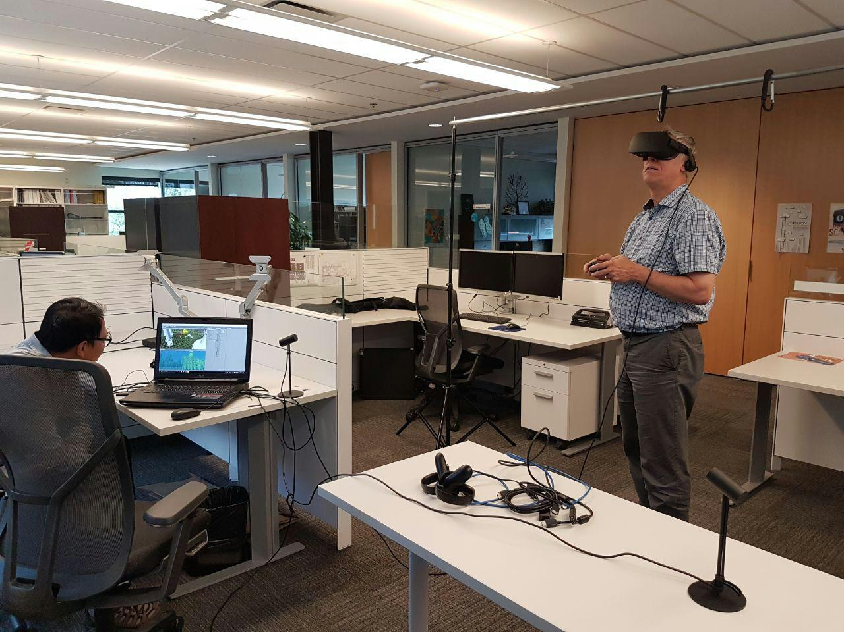
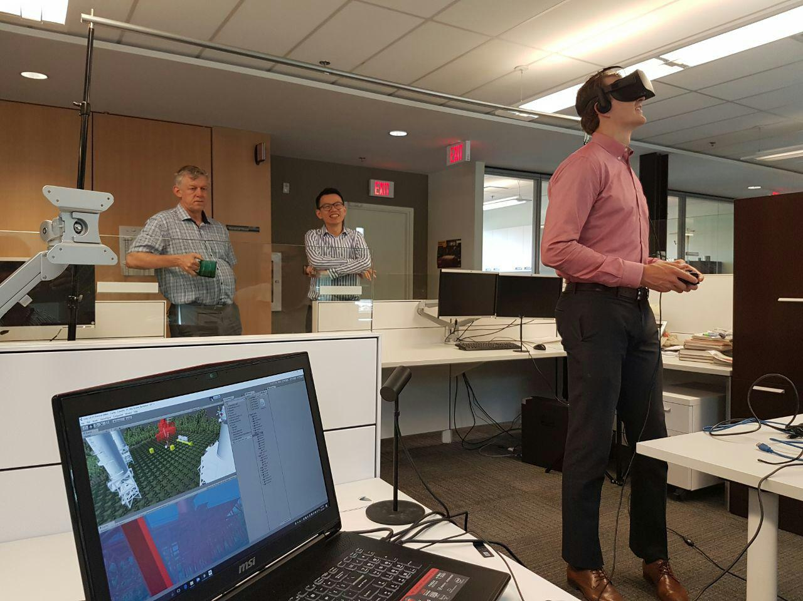
PCL engineer’s reaction

